Slide 1
Excel Capstone Project
By
Anand AL
BE – Mechanical Engineer

Slide 2
Problem statement
The growth of supermarkets in most populated cities are increasing and market competitions are also high.
The detailed report of supermarket Data is presented in this ppt.
Source of Data
This Data is taken from Kaggle Site. The dataset is one of the historical sales of supermarket company which has recorded in 3 different branches for months data.

Slide 3
Executive Summary
In this PPT, we are going to see the detailed analysis report of the sales & performance of supermarket in all 3 branches from the report of previous data of 1 year.
The sales for each time period & sales of every product type & sale in each supermarket is reported in following slides.

Slide 4
Each month Performance
In this Report the analysis is made based on performance of Sales on each month.
In this analysis the sale of each Branch & product line sales is also shown.

Slide 5
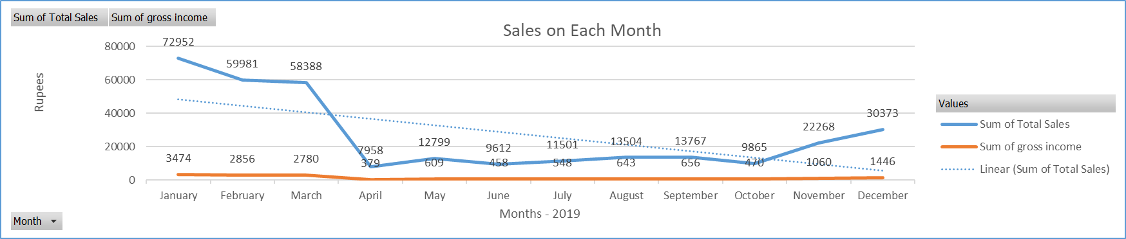
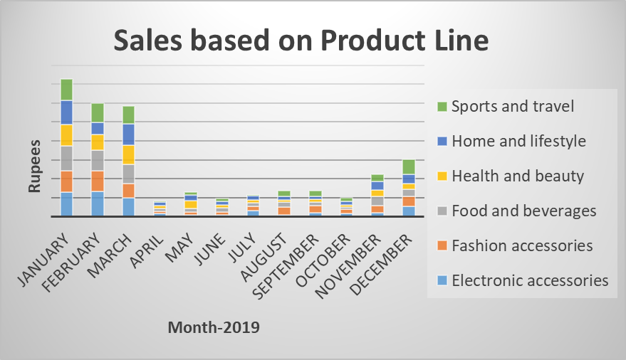

Slide 6
Report
The performance is high at January, February, march.
Then the performance is not well at april to October.
Then it is some what ok on November & December.
The sale is high in January, Febraury, March & it gradualy decrease & the increase in November & December.

Slide 7
Each Branch Performance
The analysis chart is made to analysis the performance of each branch.
In this we are going to analysis the total sales, Avg. Rating & subscribed customer in each Branches

Slide 8
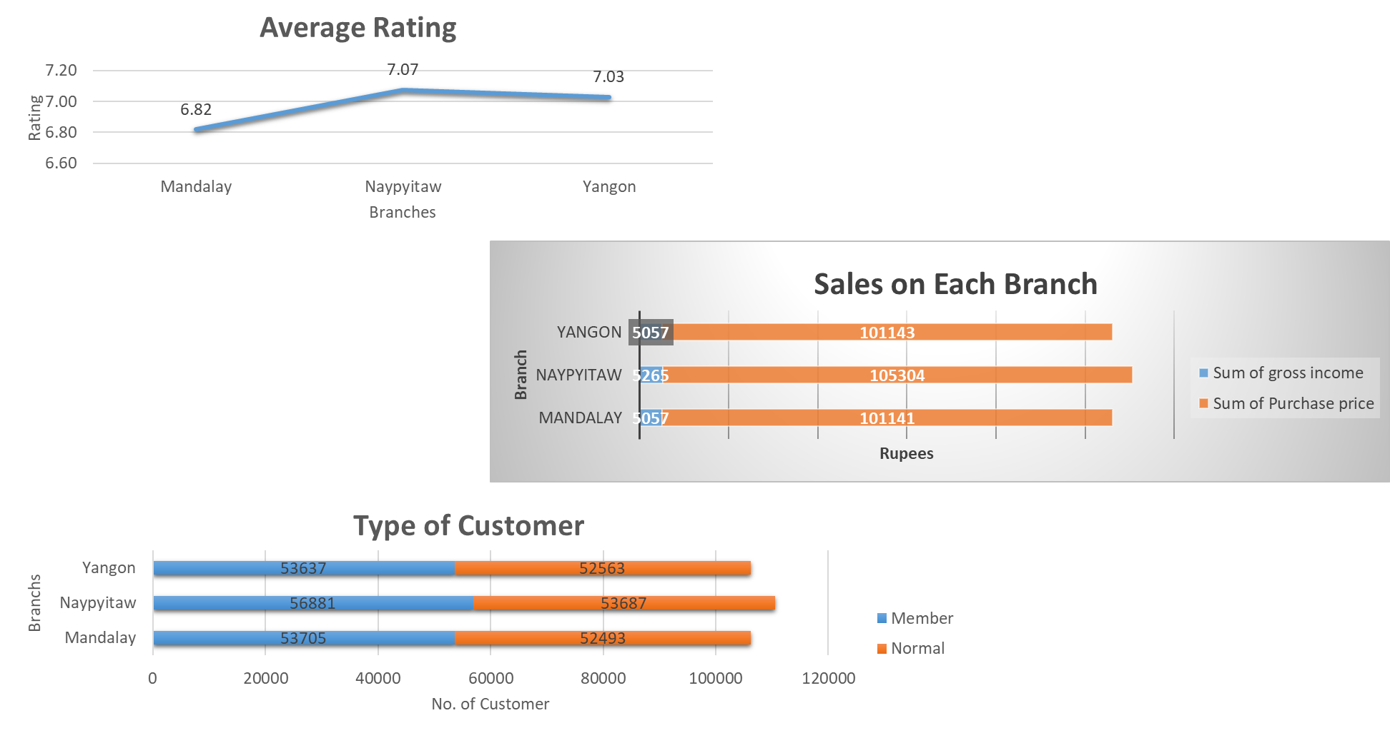

Slide 9
Report
From the report, the branch in Naypyitaw is performing well when compare to other.
The avg. Rating of customer is 7.07 in Naypyitaw.
Then the performance of Yangon is good.

Slide 10
Product Line Performance
In this the report of total sale based on Transaction Type, Branches, customer type.
Various Transaction types:
Customer Type: Member & Normal
Cash
E-wallet
Credit Card

Slide 11
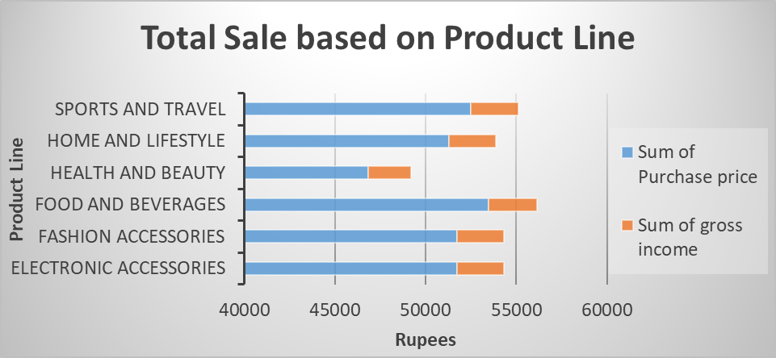
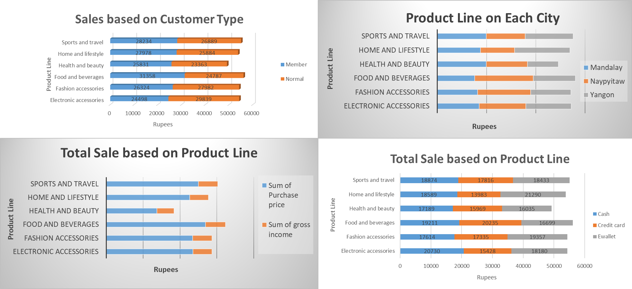
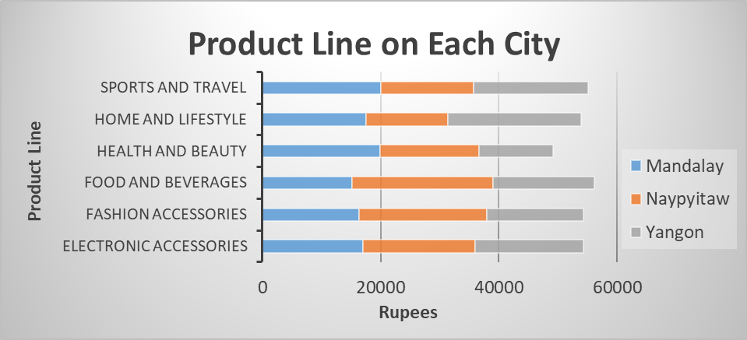

Slide 12
Report
The high sales in product line is from Food & beverage Department
Then the second one is Sports & Travel

Slide 13
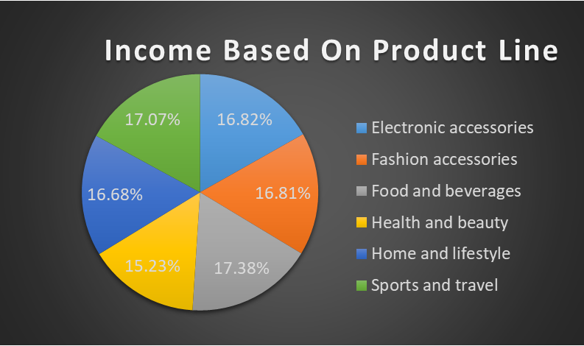
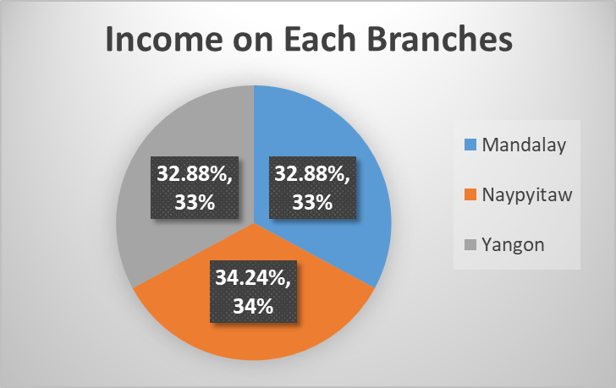
Gross Income
In this the Gross Income is Analysed based on each branch shop & product type.
The income is high on food & sports product.
The income is high in Naypyitaw

Slide 14
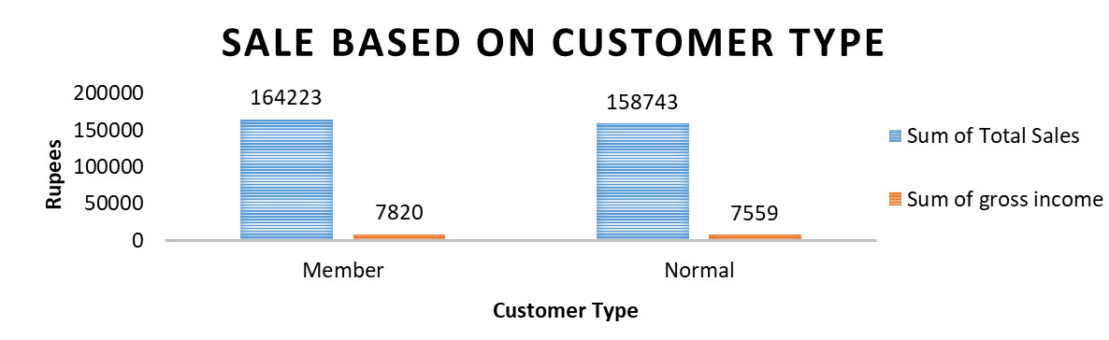
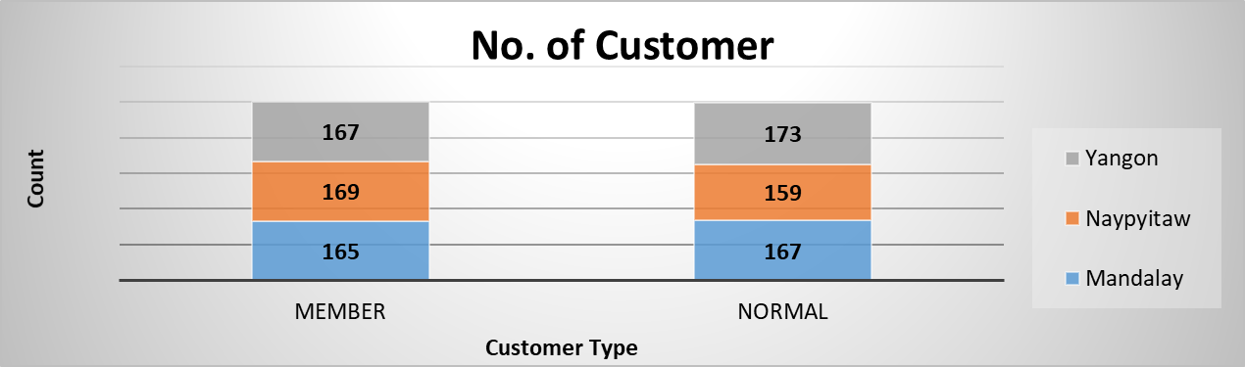
Customer Type
The sale based on Customer type is shown in following analysis chart

Slide 15
Conclusion
From this report we concluded that performance of super market in Naypyitaw is better when compare to the performance of other super market.
From this we need to focus on sale from April to October to improve sale.
We need to increase made the new customer to subscribe our membership.

Slide 16

External Links
Dashboard – Excel | Excel in .xlsm Formate
Presentation Video | Video in .mp3 [YOUTUBE] Format

Slide 17
THANKS YOU

